Slide 1
Project Fizz
Objective: Increase significant revenue by optimizing retail store displays

Slide 2
Rob Gehring
Porter Jenkins
Cary Jenkins
Brad Curtis
Swire Corporation

Slide 3
Key Sales Levers
Two key levers identified. Quantify ability to increase sales and effort to implement
Display Location
Display Configuration
Objective: Identify optimal in-store display locations to drive revenue
Key variables to capture
In-store location (end cap, front/back, etc…)
Category location (bakery, deli, pharmacy)
Co-merchandise/adjacent products (s’mores example)
Competitor location – how far from Pepsi?
Example
Checkout #3 refrigerator
Next to snacks/candy
Measure sales
Capture restocking by merchandiser?
Objective: Identify optimal brand configurations for displays
Photo machine learning needed to make viable
Iterative testing required to validate
Requires investment in hands-on research.
Measure Sales
Capture restocking
Also provided by researcher

Slide 4
Phased Development Plan
Research
Validate we can increase sales and provide measurable ROI
Exit with product requirements to build viable solution for Swire.
Build
Deploy solution for Swire that delivers measurable and repeatable revenue increase.
Exit with product that can scale and deliver ROI
Grow
Ramp customer acquisition.
Identify and expand into additional CPG categories

Slide 5
Phased Approach
Research - Bootstrap business validation and initial development
 | Objective | Requirements | Project Team | Swire
Research | Validate that we have the ability to measurable increase sales. Scope effort required to develop and deploy solution. Prioritize deliverables required to capturing paying customer | Identification of business requirements Access to stores and displays for testing Access to key participants (field sales, merchandisers, etc..) Sales Data Technology to capture, analyse and present recommendations | Research and validate business impact Porter – PhD research Brad – Act as product manager Rob – Business requirements and access to required resources Cary – Technical direction. | No direct financial investment Benefit from PhD thesis Provide subject expertise and identification of business requirements Access to key elements and information Provide sales data Upon acceptance of validation a commitment to be paying customer

Slide 6
Objective: Increase customer revenue and margins at the store level
Provide recommendations on in-store POS merchandising displays that increase revenue and margin. Key elements include
Display location within store (custom by store)
Brand configuration and size
Co-merchandising elements (s’mores example)
Competitive displays
Ad participation
Stores level analysis and recommendations
Layouts unique
Seasonality
Competitive impact

Slide 7
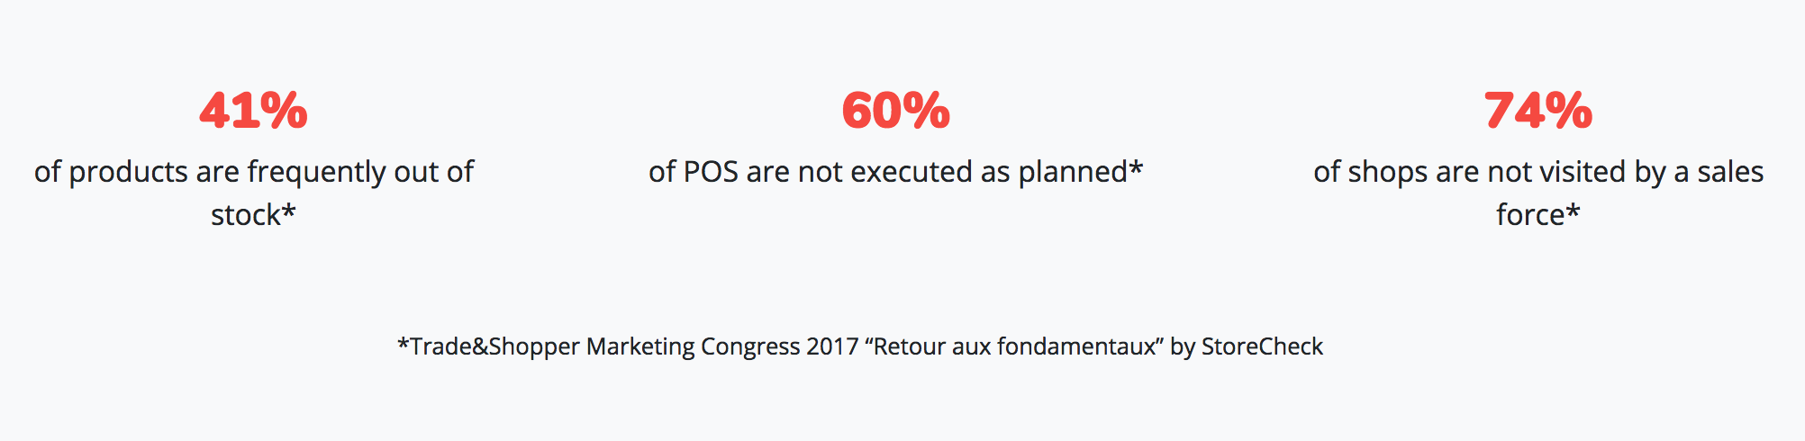
Customer Pain Points

Slide 8
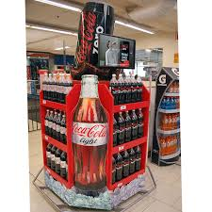
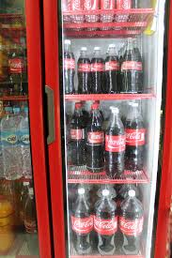
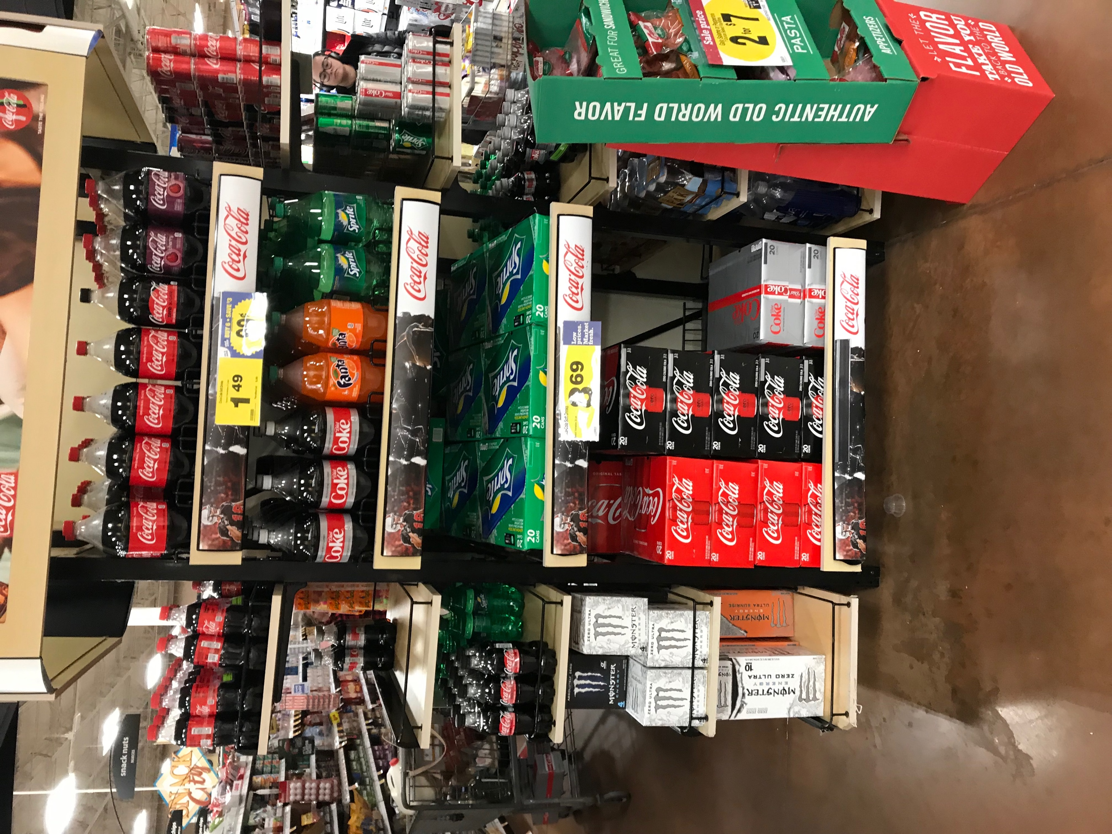
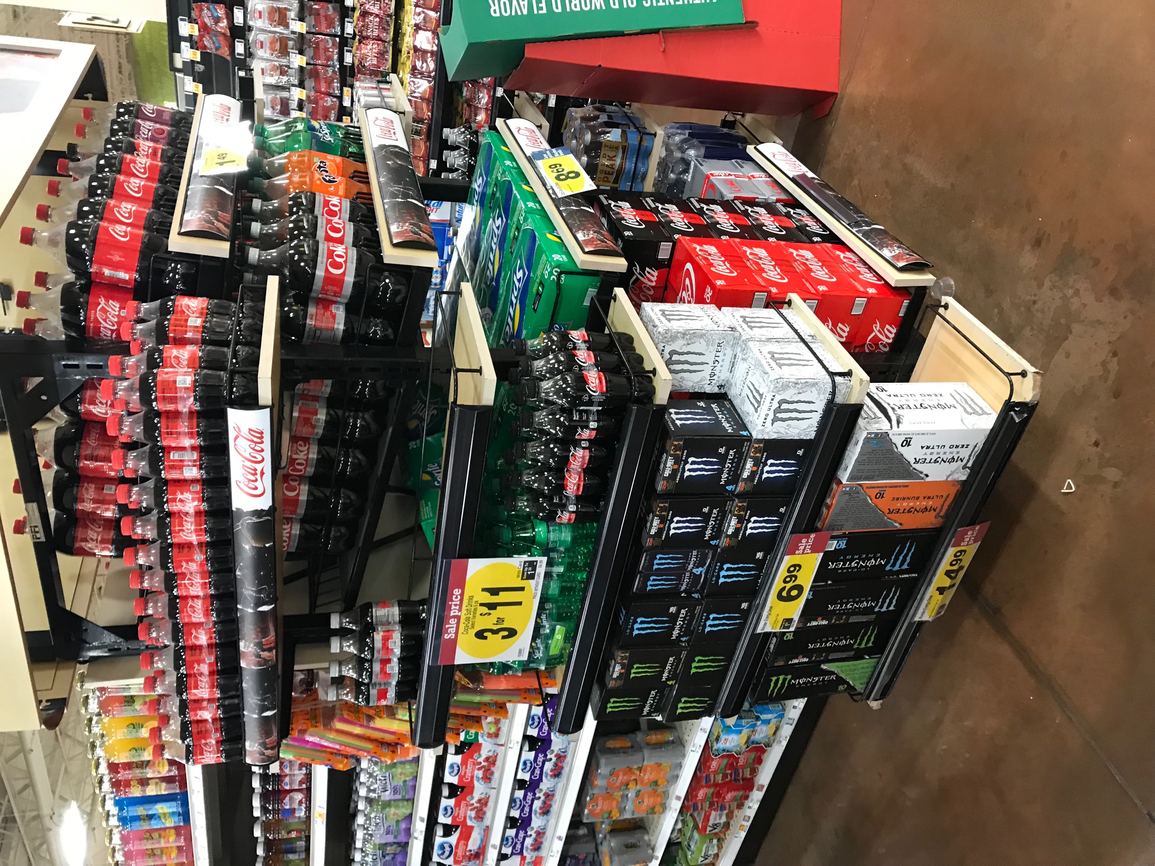
Key Elements
App to capture data needed
POS Data
Product Displays
Merchandiser
Sales at display level
Build and stock displays and shelves
Capture sales by SKU at restocking?
Use app to input information
App photo track compliance
Brand Configuration
How displays are merchandised
Photo in app – track compliance
Field Sales
Capture competitive information
Location of Pepsi displays
Brand configuration (deconstruct photo)
Engage store manager with recommendations
X store selling X% more than you
Change POS to improve sales

Slide 9
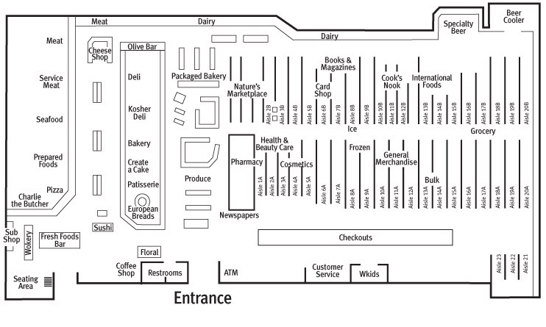
Which POS display are best performing?

Slide 10




Slide 11
POS Configuration
What is optimal brand configuration?
By location
Competitive POS location
Co-merchandising (s’mores)
Diet Coke 6-pack understocked in example

